Slide 1
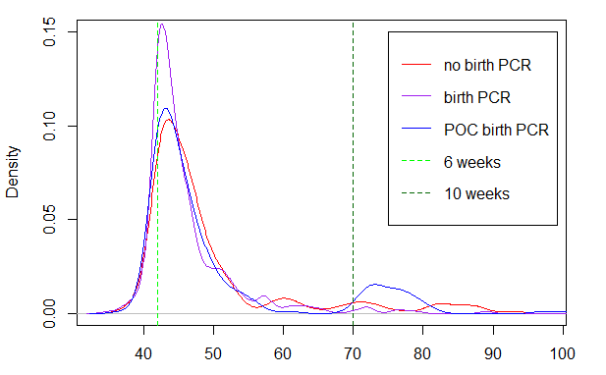
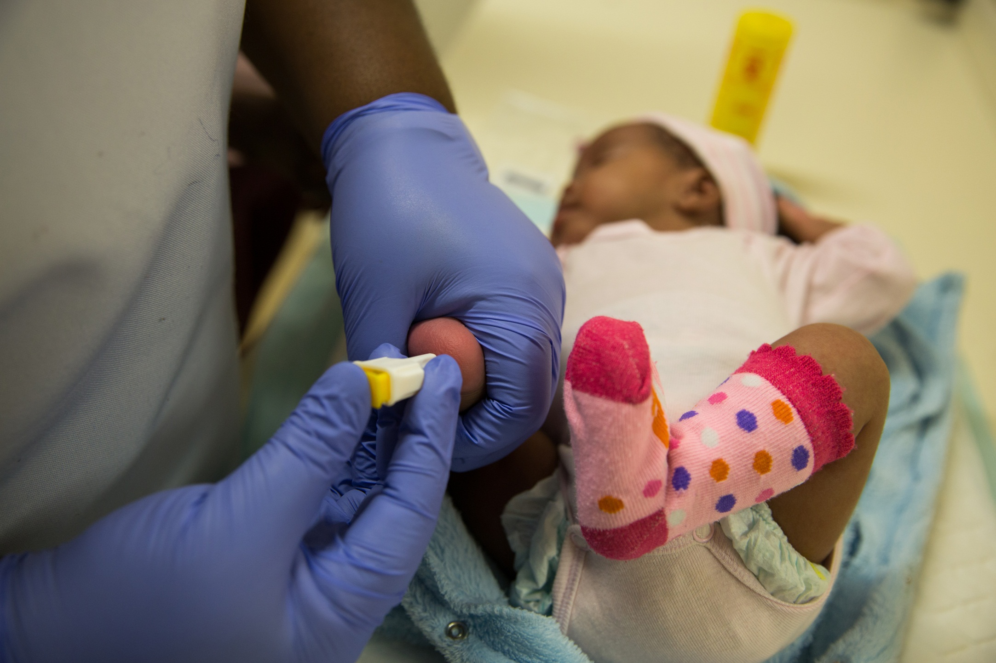
Abstract 791
Impact of Birth PCR on Retention in Care of HIV Exposed Infants in Primary Care
Aurelie Nelson¹, Laura Trivino Duran¹, Tali Cassidy¹, Gilles Van Cutsem¹, Sarah-Jane Steele¹, Mark Cotton², Janet Giddy³, Jean Maritz⁴
¹MSF South Africa
²Paediatrics, Stellenbosch University and Tygerberg Children’s Hospital
³Khayelitsha and Eastern Sub-Structures (KESS), Provincial Government Western Cape
⁴Medical Virology, NHLS, Stellenbosch University
BACKGROUND
RESULTS
The World Health Organization recently recommended birth testing for all HIV-exposed infants (July 2016). Birth polymerase chain reaction (PCR) in this population was introduced in June 2015 in South Africa.
There is an increased interest in point of care (POC) technology for birth testing to improve early retention in care and treatment initiation. However, there is little data on the impact of either birth PCR or POC technology on longer term retention in care. We describe the impact of birth PCR (including POC) on retention in care at 6-10 weeks.
 | a) No birth testing | b)Birth PCR (lab) | c) Birth PCR (POC)
N (%) return for 6-10 week PCR | 197 (62%) | 339 (78%) | 241 (75%)
Median days (IQR) | 46 (43-50) | 44 (42-47) | 45 (43-50)
Overall, the two groups with birth PCRs were more likely to return than the historical controls
(RR: 1.3 [95% CI:1.07-1.5])
✶
Day
Figure 1. Khayelitsha, a high- HIV-prevalence settlement in Cape Town, South Africa
Figure 2. Density plot of PCR done at 6 weeks or 10 weeks among 3 comparative groups
✶Note: 10 week testing was introduced during the follow up time of group c (POC), explaining the blue line bump at 70 days
METHODS
Conclusion
We compared the completion of routine 6-10 weeks testing (range: 5-15 weeks) for three groups of HIV-exposed infants with varying risk of HIV transmission born in a primary care clinic, Khayelitsha, South Africa :
Birth PCR did not negatively impact return for further testing at 6-10 weeks. Limitations to this study include using a historical control. The extra counseling the two latter groups received could have also positively influenced their return for further infant testing.
 | a) No birth testing | b) Birth PCR (lab) | c) Birth PCR (POC)
Birth test | None | Roche CAP/CTM assays | Alere Q
Dates | August 2013 -March 2014 | Nov 2014 – July 2015 | August 2015 -April 2016
N | 321 | 336 | 321
Other |  | Extra counselling from study nurse on routine infant testing*
*For the purposes of this analysis, those who returned only after tracing were not classified as completing 6-10 weeks PCR to improve comparability between the three groups
Figure 3: MSF nurse testing a newborn for HIV PCR

